Slide 1

Research Methodology
Conclusion and References
Dr. Arti Arya
Department of Computer Science and Engineering

Slide 2



Research Methodology
Conclusion Section
The conclusion is an interpretation of the facts you gathered and discussed.
It is not a repetition of the facts.
It is not an action that one must take.
Why Conclusion?
Tie together, integrate and synthesize the various issues raised in the discussion sections, while reflecting the -Introduction, Problem Statement or Objectives
2. Provide answers to the research question (s)
3. Identify the theoretical implications of the study
4. Highlights the study limitations
5. Provide direction and areas for future research

Slide 3
Research Methodology
Conclusion Section
Why Conclusion?
1. Tie together, integrate and synthesize the various issues raised in the discussion sections, while reflecting the -Introduction, Problem Statement or Objectives
2. Provide answers to the research question (s)
3. Identify the theoretical implications of the study
4. Highlights the study limitations
5. Provide direction and areas for future research

Slide 4

Research Methodology
Conclusion Section
Conclusion should highlight
Advantages of the work
Novelty in the work
Limitations of the work
Suggestions for further work

Slide 5


Research Methodology
A good Conclusion is…..
A logical ending synthesizing what has been previously discussed and never contain any new information or material.
It must pull together all of the parts of your argument and refer the reader back to the focus you have outlined in your introduction and to the central topic and thereby create a sense of unity.
Be very systematic, brief and never contain any new information
Add to the overall quality and impact of the research.

Slide 6

Research Methodology
What should be the content of a good Conclusion?
Restate the research questions which reinforces the importance of the study and its findings.
Empirical Findings: summary of the main finding in the different chapters provide answers to or the specific research
Theoretical Implication: Present a modest position of how the work has contributed to existing understanding of concepts that has been investigated.
Recommendation for future research: Further research that has not been covered but is worthwhile to investigate in the near future.
Limitation of the study: Identify the various limitations which were encountered during the sampling, lab work, data collection and analysis stages of the research or project.

Slide 7

Research Methodology
Conclusion Section

Slide 8
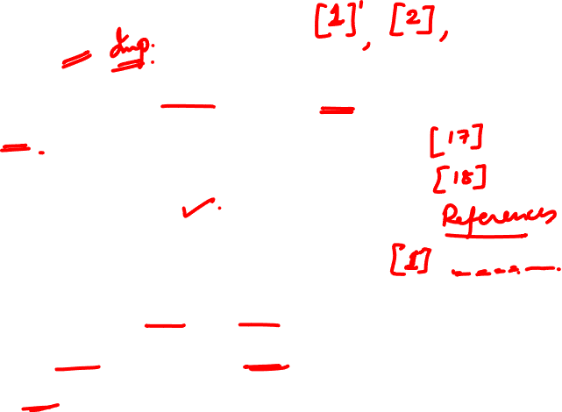
Research Methodology
References
A referencing style is a specific format for presenting in- text references (footnotes or endnotes), and bibliography.
It is a act of referring.
References:
The action of mentioning to something or,
The use of a source of information in order to ascertain something.

Slide 9
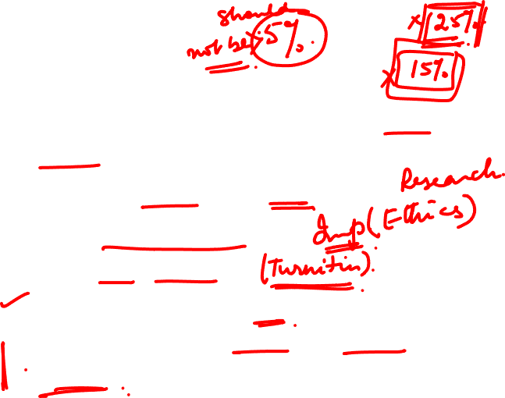
Research Methodology
Why References?
Proves that substantial research has been done to support our analysis .
Enables others to follow up on our work .
Gives credit to other people's work .
Avoids charges of plagiarism.
Required to support all significant statements.
Used to indicate the origin of material & source for research & further reading.

Slide 10

Research Methodology
Why Reference?
https://www.youtube.com/watch?v=NDgqqPvMn0U

Slide 11

Research Methodology
Types of References?
Journal Reference
Book Reference
Internet Reference

Slide 12

Research Methodology
Referencing Styles?
Harvard style of referencing.
American Psychological Association style (APA) .
Vancouver style.
MLA citation style (Modern Language Association ).
The Chicago manual of style .
Royal society of chemistry style.

Slide 13

Research Methodology
Harvard Reference?
Author’s name followed by its initials.
Year of publication.
Article title with single quotation mark followed by full stop.
Name of Journal in italic form.
Volume followed by a comma
Issue no. in bracket.
Page no.
Examples
Padda, J. (2003) ‘creative writing in coventry'. Journal of writing studies 3
(2), 44-59.
Prasad, M.C., Florence, L. and Arya, A., (2015) ‘ A study on software metrics based software defect prediction using data mining and machine learning techniques’. International Journal of Database Theory and Application, 8(3), pp.179-190.

Slide 14

Research Methodology
Vancouver Referencing Style
Author Surname followed by Initials.
Title of article followed by double quotation.
Title of journal (abbreviated).
Date of Publication followed by semicolon.
Volume Number.
Issue Number in bracket.
Page Number.
Example
1. Haas AN, Susin C, Albandar JM, et al. "Azithromycin as a adjunctive treatment of aggressive periodontitis: 12-months randomized clinical trial". N Engl J Med. 2008 Aug; 35(8):696-704.
Vancouver Style does not use the full journal name, only the commonly- used abbreviation: “New England Journal of Medicine” is cited as “N Engl J Med”.

Slide 15
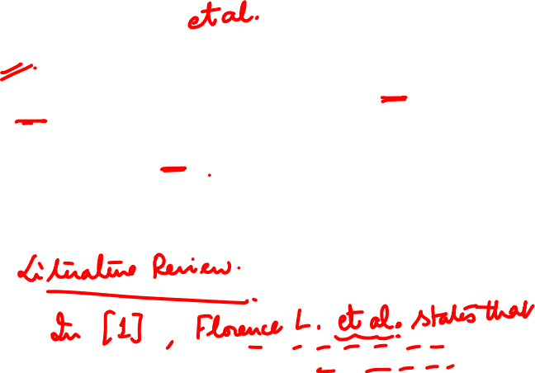
Research Methodology
What is et al.?
Et al. comes from the Latin phrase meaning “and others.”
It is usually styled with a period, but you will occasionally see et al as well.
Et al. typically stands in for two or more names, especially in bibliographical information

Slide 16

Research Methodology
MLA Referencing?
Authors name.
Title of article.
Name of journal.
Volume number followed by decimal & issue no.
Year of publication.
Page numbers.
Medium of publication.
Example
Matarrita-Cascante, David. "Beyond Growth: Reaching Tourism-Led Development." Annals of Tourism Research 37.4 (2010): 1141-63. Print
Prasad, M. C., Lilly Florence, and Arya, A. "A study on software metrics based software defect prediction using data mining and machine learning techniques." International Journal of Database Theory and Application 8.3 (2015): 179-190.Print

Slide 17

Research Methodology
APA ( American Psychological Association) Reference
Author’s name followed by its initials.
Year of publication.
Article title followed by full stop.
Name of Journal in italic form
Volume followed by a comma
Page no.
Example
Alibali, M. W., Phillips, K. M., & Fischer, A. D. (2009). Learning new problem-solving strategies leads to changes in problem representation. Cognitive Development, 24, 89-101.
Prasad, M. C., Florence, L., & Arya, A. (2015). A study on software metrics based software defect prediction using data mining and machine learning techniques. International Journal of Database Theory and Application, 8(3), 179-190.

Slide 18

Research Methodology
Chicago Referencing Style
Author’s name followed by its initials.
Article title in double quotation mark.
Title of journal in italic.
Volume.
Year of publication.
Page no.
Example
Joshua I. Weinstein, “The Market in Plato’s ” Classical Philology, 104 (2009): 440.
Prasad, M. C., Lilly Florence, and Arya, A. "A study on software metrics based software defect prediction using data mining and machine learning techniques." International Journal of Database Theory and Application 8, no. 3 (2015): 179-190.

Slide 19

Research Methodology
References vs Bibliography
Bibliography:
A separate list of sources we have.
Consulted but not specifically cited in our work including background reading. It is arranged alphabetically by the author's surname.
Reference List:
Sources we have cited in our text arranged in the order they appeared within the text.
It is usually put at the end of our work but it can also appear as a footnote (at the bottom of the page), or endnote (at the end of each chapter) which serves a similar purpose.

Slide 20
Research Methodology
Conclusion
We conclude that there are many standard style used for referencing, we can use any one of them.
It gives us a standard format of presenting or reference.
Supports or significant statement and helps to know origin of work.
Plagiarism can be avoided.

Slide 21
THANK YOU
Dr. Arti Arya
artiarya@pes.edu

